Slide 1
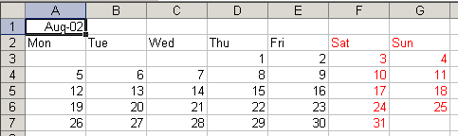
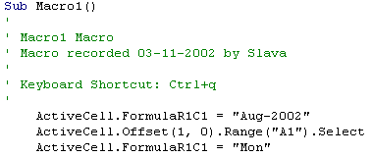
…
ActiveCell.Offset(0, 1).Range("A1").Select
ActiveCell.FormulaR1C1 = "Tue"
…
Selection.Font.ColorIndex = 3
ActiveCell.FormulaR1C1 = "Sat"
…
ActiveCell.Offset(1, -3).Range("A1").Select
ActiveCell.FormulaR1C1 = "1"
…
ActiveCell.Offset(1, -6).Range("A1").Select
ActiveCell.FormulaR1C1 = "5“
…
ActiveCell.FormulaR1C1 = "31"
ActiveCell.Offset(-6, -5).Range("A1").Select
End Sub

Slide 2
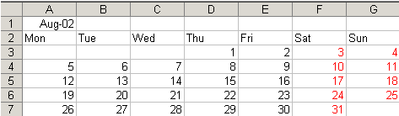
Sub Macro2()
StartRow = ActiveCell.Row
StartColumn = ActiveCell.Column
Cells(StartRow, StartColumn) = "Aug-2002"
Cells(StartRow + 1, StartColumn) = "Mon"
Cells(StartRow + 1, StartColumn + 1) = "Tue"
Cells(StartRow + 1, StartColumn + 2) = "Wed"
Cells(StartRow + 1, StartColumn + 3) = "Thu"
Cells(StartRow + 1, StartColumn + 4) = "Fri"
Cells(StartRow + 1, StartColumn + 5) = "Sat"
Cells(StartRow + 1, StartColumn + 6) = "Sun"
ActiveCell.Offset(2, 3).Range("A1").Select
ActiveCell.FormulaR1C1 = "1"
…
…
Cells(StartRow + 1, StartColumn + 6) = "Sun"
DayNumber = 1
StartDay = 3
For WeekofMonth = 0 To 5
For DayofWeek = StartDay To 6
Cells(StartRow + 2 + WeekofMonth, StartColumn + DayofWeek) = DayNumber
DayNumber = DayNumber + 1
Next DayofWeek
StartDay = 0
Next WeekofMonth
End Sub

Slide 3
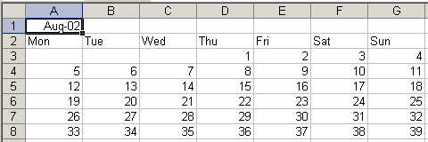
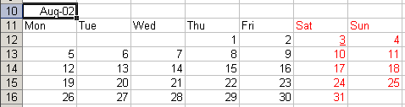
For WeekofMonth = 0 To 5
For DayofWeek = StartDay To 6
If DayNumber < 32 Then
Cells(StartRow + 2 + WeekofMonth, StartColumn + DayofWeek) = DayNumber
End If
DayNumber = DayNumber + 1
Next DayofWeek
StartDay = 0
Next WeekofMonth
ActiveCell.Offset(1, 5).Range("A1:B6").Select
Selection.Font.ColorIndex = 3
ActiveCell.Offset(-1, -5).Range("A1").Select
End Sub

Slide 4
Public Sub Macro3()
YearNumber = "2002"
NameofMonth = "August"
…
Cells(StartRow, StartColumn) = NameofMonth & "-" & YearNumber
…
StartDay = Weekday("1-" & NameofMonth & "-" & YearNumber, vbTuesday)
…
Dim YearNumber As String
Dim NameofMonth As String
Public Sub Macro4()
YearNumber = "2002"
NameofMonth = "August"
Macro3
End Sub
Public Sub Macro3()
StartRow = ActiveCell.Row
StartColumn = ActiveCell.Column
Cells(StartRow, StartColumn) = NameofMonth & "-" & YearNumber
Cells(StartRow + 1, StartColumn) = "Mon“
…
Public Sub Macro5()
InitializeForm
MyEntryForm.Show
Macro3
End Sub

